Slide 1
10.6 Nonlinear Unsupervised Learning

Slide 2
Modeling principles

Slide 3
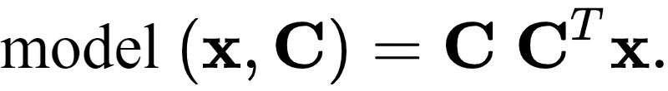
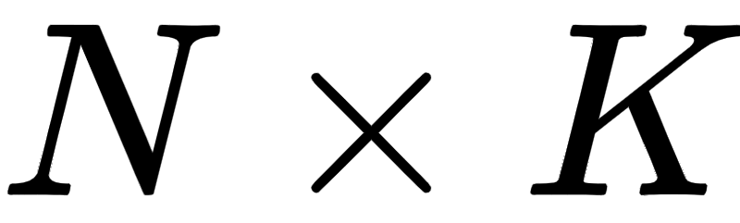


The linear Autoencoder model
is parameterized by the matrix that will act as our recovered basis upon minimization of the cost function

Slide 4
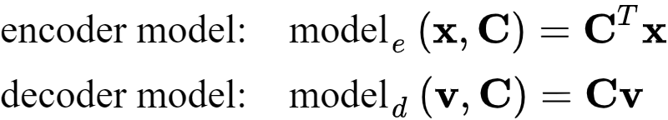
We can decompose the linear Autoencoder model into an *encoding* and *decoding* modeling sequence:
In this notation our general linear Autoencoder model is then the *composition of these two individual models* as

Slide 5
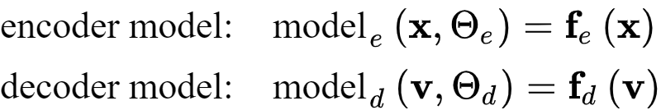
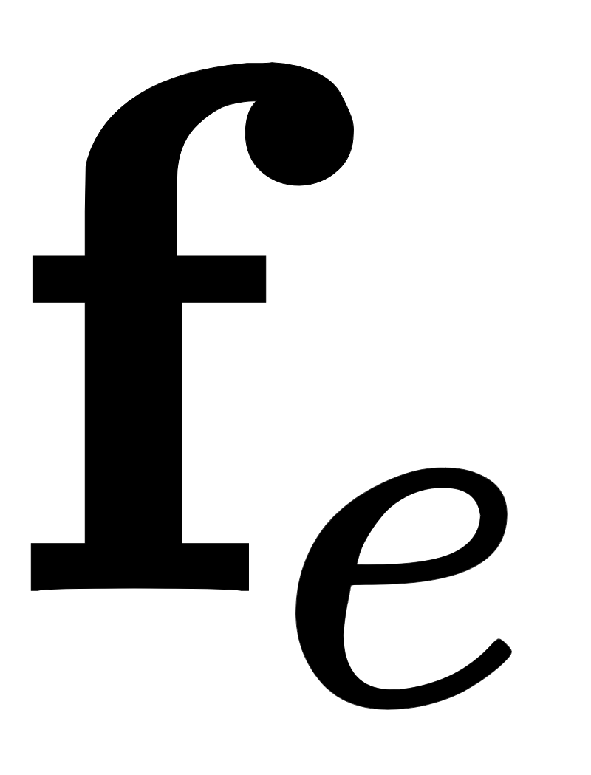
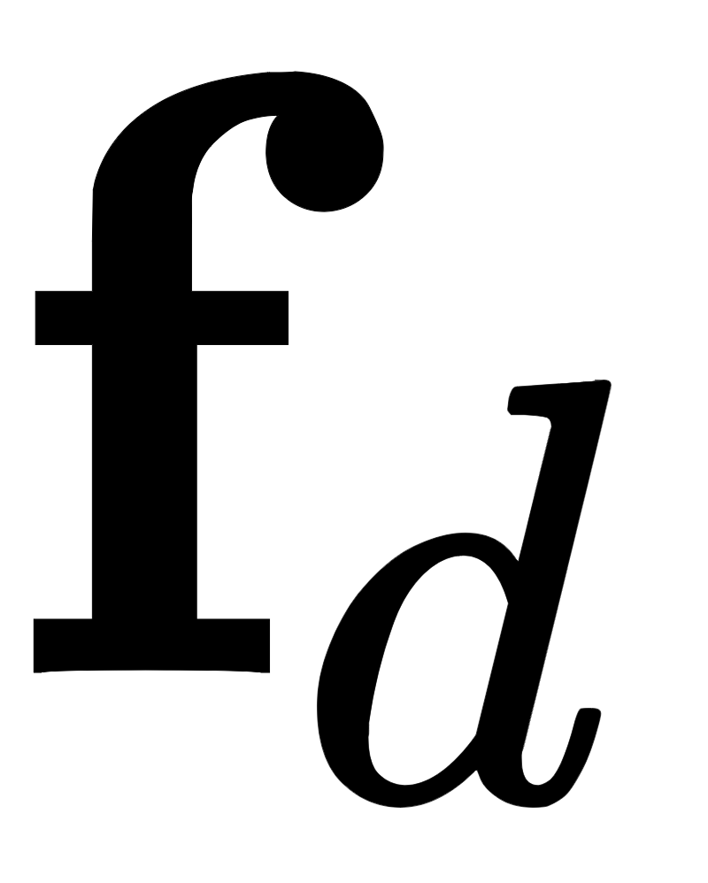
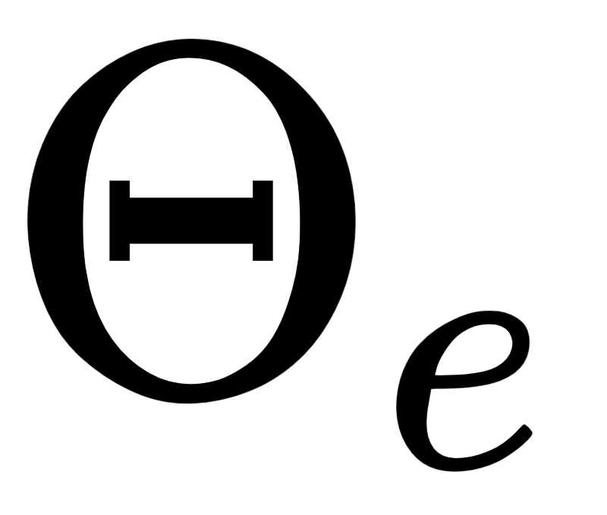
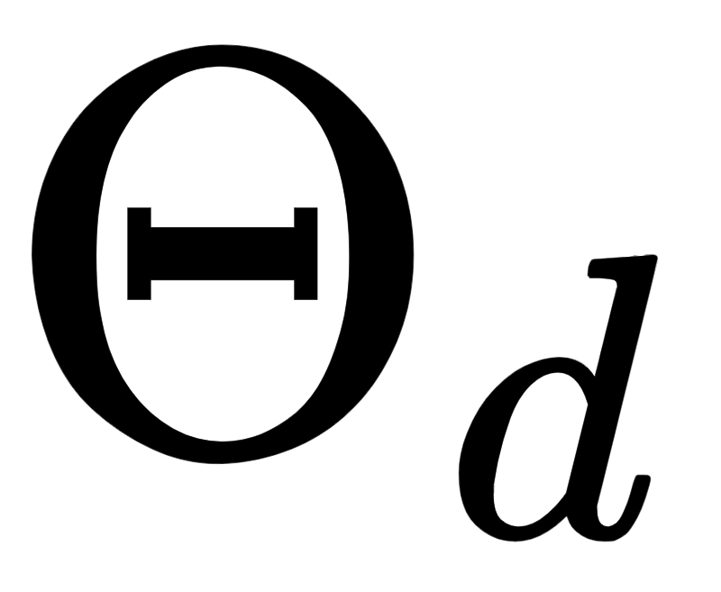
To introduce nonlinearity here, we can simply replace the linear encoder/decoder models with nonlinear versions of the generic form
Here, and are (in general) nonlinear vector-valued functions, with and denoting their parameter sets.

Slide 6


With this notation we can write the general nonlinear Autoencoder model simply as
We can tune the parameters of (which contains all parameters of and ) by minimizing the Least Squares cost

Slide 7
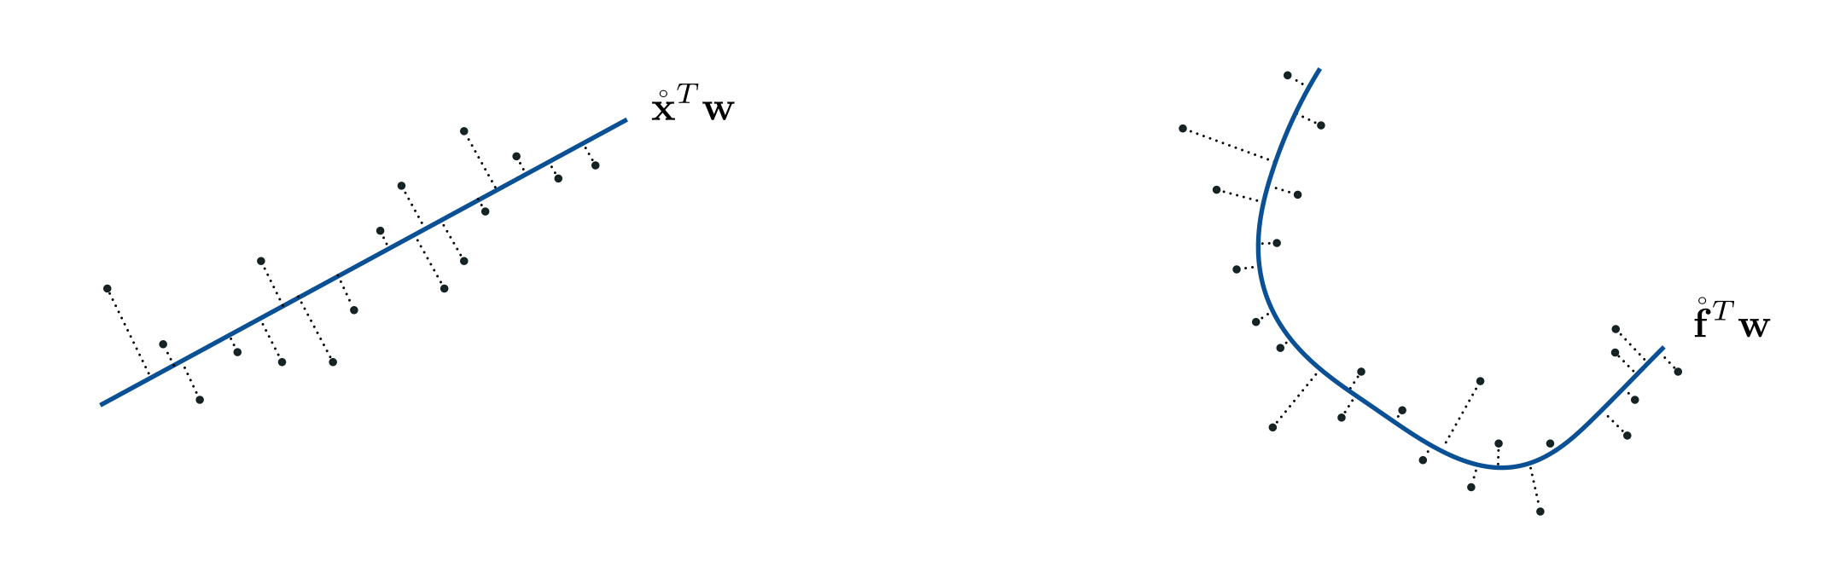
Abstract illustration of (left) linear and (right) nonlinear Autoencoder

Slide 8
Feature engineering

Slide 9
Example: Finding a circular subspace via the Autoencoder

Slide 10
In this example we use a simulated dataset of P=20 two-dimensional data points to learn a circular manifold via our nonlinear Autoencoder scheme.

Slide 11
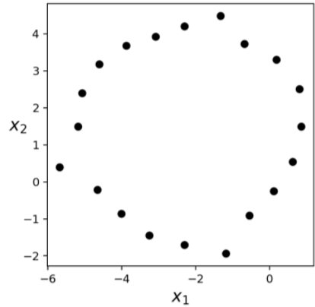

Slide 12

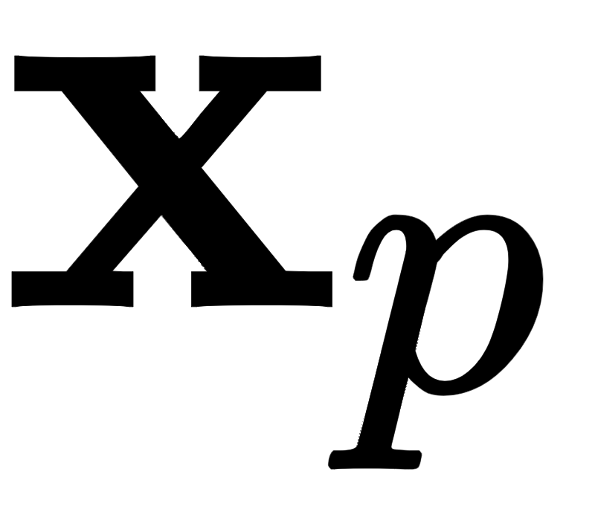
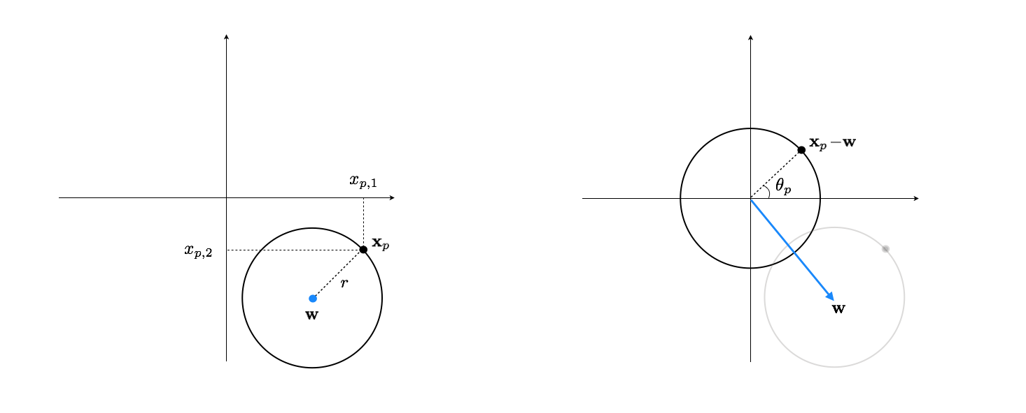
(left panel) A general circle in 2-d (left panel) can be characterized using its center point and radius r. (right panel) Subtracting off from any point on the circle then centers the data at origin.

Slide 13
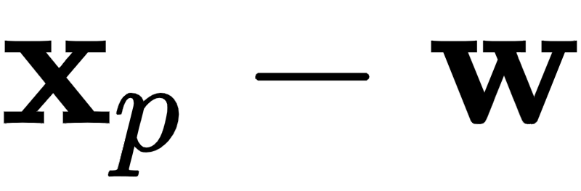
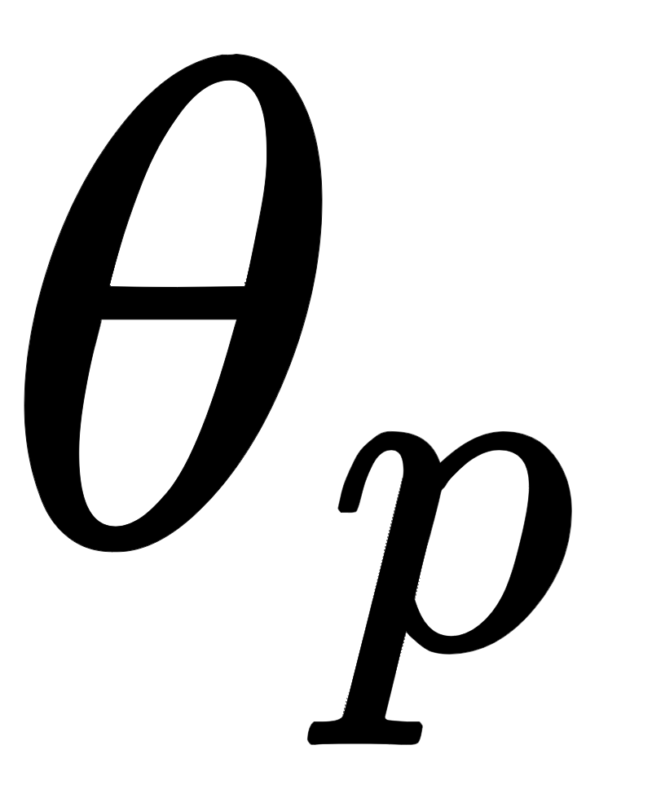
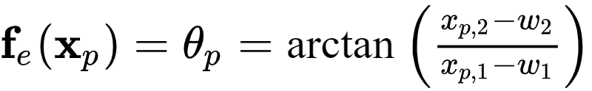
Encoder design
Once centered, any two-dimensional data point on the circle can be encoded as the (scalar) angle between the line segment connecting it to the origin and the horizontal axis.

Slide 14
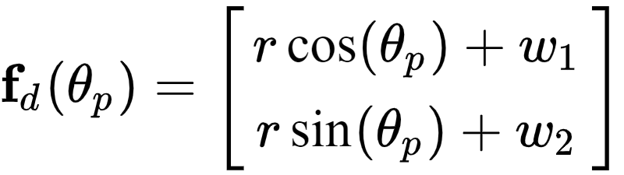
Decoder design
To design the decoder, beginning with , we can reconstruct as

Slide 15
Using gradient descent we can now minimize the Autoencoder cost, finding the optimal encoder/decoder parameters for this dataset.

Slide 16
